Slide 1


SMART INDIA HACKATHON 2025
TEAM DHRUVA
Problem Statement ID: SIH26001
Problem Statement Title: AI-Based early warning and landslide Risk Monitoring System in NER
Theme: Disaster Management
PS Category- Software/Hardware: Software

Slide 2







TEAM DHRUVA
TEAM DHRUVA
Proposed Solution (Describe your Idea/Solution/Prototype)
•
SLOPE-X Platform: An AI-powered real-time slope intelligence system transforming static landslide maps into 6h–72h predictive warnings.
•
Physics-Informed 3D Digital Twin: Continuously monitors pore-water pressure, soil saturation, and slope displacement for critical mountain terrain.
Multi-Source Feeds
3D Slope Twin
•
Multi-Sensor Fusion Engine: Integrates Sentinel-1 InSAR radar, DEM elevation, IMD rainfall feeds, and ground-level IoT moisture sensors into one map.
InSAR, IMD Rain & IoT Sensors
Real-Time Pore Water Pressure
Ensemble AI
Offline Mesh Sync
•
GIS Command Dashboard: Mapbox & Next.js dark interface providing localized risk heatmaps, community evacuation routes, and automated siren triggers.
XGBoost & LSTM Lead Time
PWA Disaster Resilience
COMMAND CENTER & EARLY WARNING FLOW
•
Offline-First Resilience: Utilizes PWA edge caching & mesh synchronization to ensure full alert operations during network and power blackouts.
Risk Engine
Live GIS Map
Early Alerts
•
Proactive Impact: Shifts regional disaster management from reactive flood/landslide response → data-driven preventive action.
2

Slide 3
TEAM DHRUVA
What is the problem?
1. Difficulty in identifying high-risk landslide/flood zones in advance
2. Lack of localized, real-time risk information
3. Delayed or non-actionable early warnings
4. Difficulty prioritizing the most critical locations for response
5. Roads and evacuation routes becoming unsafe or blocked
6. Fragmented disaster information from multiple sources
7. Communication/network failure during disasters
8. Rapidly changing ground and environmental conditions

Slide 4
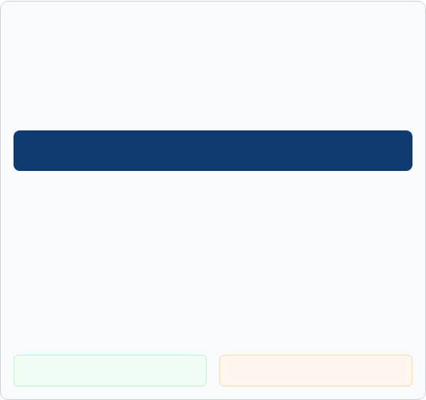





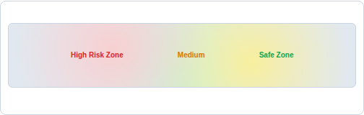
TECHNICAL APPROACH
TEAM DHRUVA
•
Integrates Sentinel-1 InSAR satellite, DEM terrain, IMD rainfall feeds & IoT sensors into a unified PostGIS spatial datastore.
•
Constructs a physics-informed 3D slope digital twin to compute continuous pore-water pressure and shear strength in real time.
SLOPEX ENSEMBLE AI ENGINE
•
Utilizes an ensemble AI engine (XGBoost + LSTM) for dynamic slope susceptibility scoring and 6h–72h predictive warnings.
XGBoost Risk Indexing • 3D Digital Twin • 6h–72h LSTM Prediction
•
Delivers a Next.js & Mapbox GIS command center displaying live hazard heatmaps, evacuation routes & automated sirens.
LIVE RISK MAP & GIS COMMAND DASHBOARD
•
Provides offline-first mesh synchronization and PWA caching to maintain operations during network and power blackouts.
•
Transitions regional disaster management from reactive rescue → proactive, data-driven early intervention.
EARLY ACTION
OFFLINE MESH
Timely Warnings & Sirens
Sync During Outages
3

Slide 5
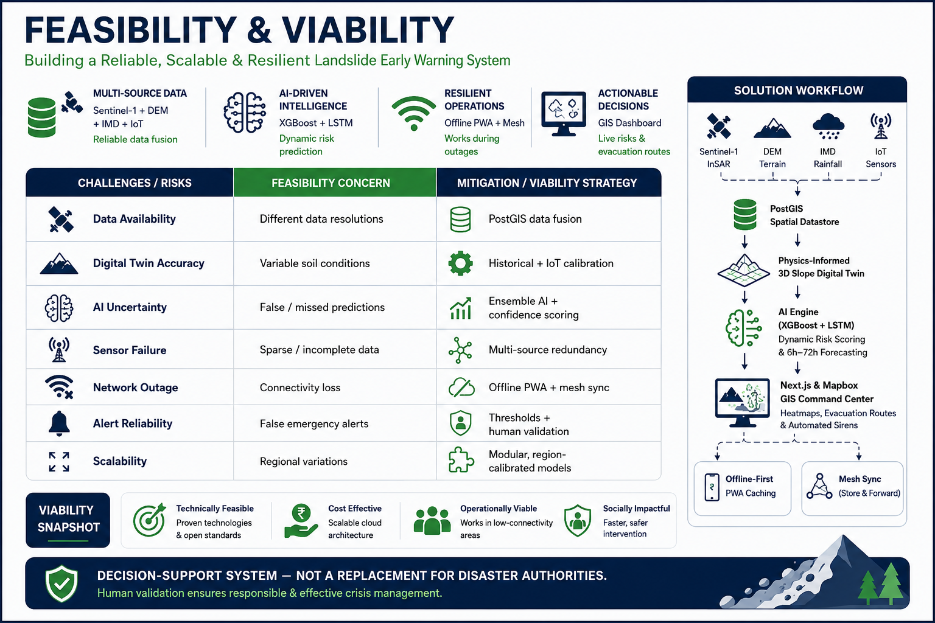
FEASIBILITY AND VIABILITY
TEAM DHRUVA

Slide 6
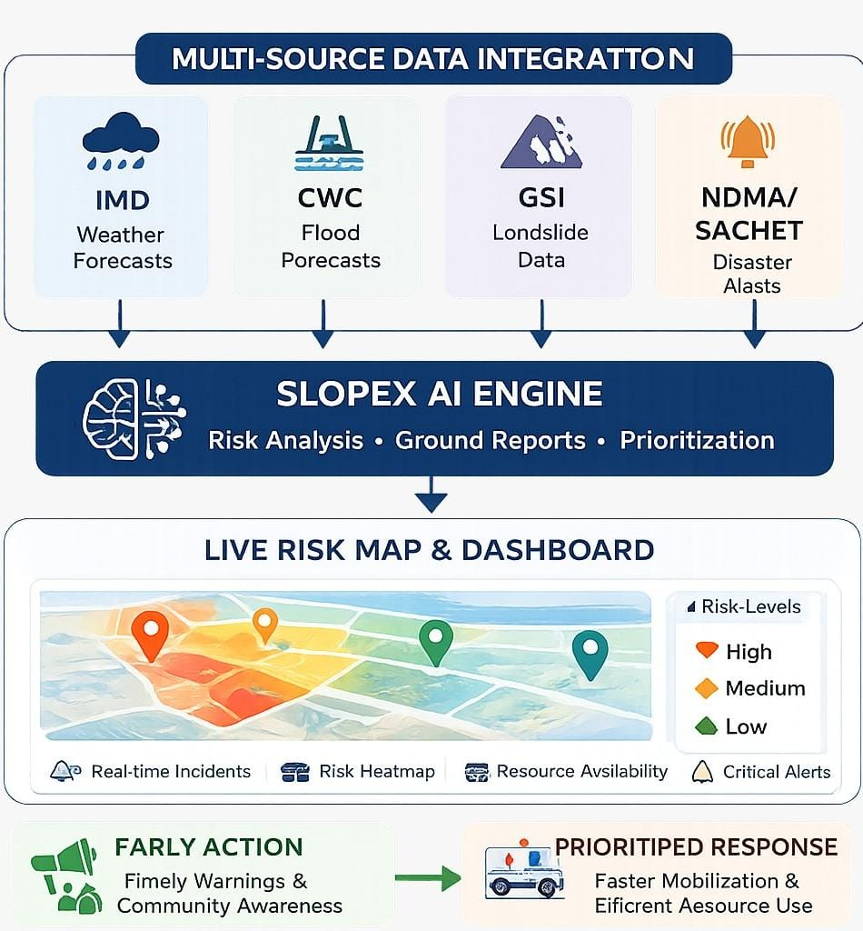
IMPACT AND BENEFITS
TEAM DHRUVA
Combines IMD, CWC, GSI & NDMA/SACHET information into one decision-support platform.
Converts multiple data sources into location-specific flood & landslide risk insights.
Integrates real-time citizen/field reports to capture changing on-ground conditions.
Helps authorities identify high-risk zones and critical incidents first for faster action.
Enables offline access and local data capture, supporting communication during connectivity failures.
Moves disaster management from reactive response → proactive, data-driven action.

Slide 7
RESEARCH AND REFERENCES
TEAM DHRUVA
ISRO–NRSC (2023) — Landslide Atlas of India: Mapping, Monitoring and Advance Techniques Using Space-Based Inputs
NRSC–ISRO & ASDMA (2025) — Flood Hazard Zonation Atlas of Assam: Using Multi-Sensor Satellite Data (1998–2023)
Sharma, M. & Laskar, S. (2025) — An IoT Based Landslide Monitoring and Early Warning System for Guwahati City
Ramesh, M. V. et al. (2022/2023) — Landslide Early Warning Systems: Requirements and Solutions for Disaster Risk Reduction—India
Geological Survey of India — National Landslide Forecasting Centre (NLFC)

Slide 8
TEAM MEMBERS
TEAM DHRUVA
 | Name | Reg. No. | Dept. | Year of Study | Semester | Gender | Email id | Mobile no.
Team Leader | Deven Jamaria | RA2511019010086 | Aerospace Engineering | 2 | 3 | Male | dj3601@srmist.edu.in | 9904611148
Team Member | Om Agrawal | RA2511019010099 | Aerospace Engineering | 2 | 3 | Male | oa7804@srmist.edu.in | 8085318609
Team Member | Paarth Mukherjee | RA2511019010082 | Aerospace Engineering | 2 | 3 | Male | pm5949@srmist.edu.in | 6385446089
Team Member | Vijeta Sargam | RA2511030010079 | Networking and Communication | 2 | 3 | Female | vs2991@srmist.edu.in | 9693536234
Team Member | Avaneesh Chandrashekhar Shettigar | RA2511019010119 | Aerospace Engineering | 2 | 3 | Male | as7591@srmist.edu.in | 9380343795
Team Member | Prithviraj Ketkale | RA2511018010060 | Mechatronics engineering (Core) | 2 | 3 | Male | pk4770@srmist.edu.in | 9021792778
Faculty Mentor (Mandatory) | Dr. KS Vignesh |  | Associate Professor Mechanical Engineering |  |  | Male | vigneshk1@srmist.edu.in | 96008 80411
Industry Mentor (Mandatory) | Dr.Manikanda Bharathi |  |  |  |  | Male | ceo@aquaforgerobotics.com | 89402 95211

